Slide 1


2025 Request for Qualifications (RFQ)
Professional Services: Runway Protection Zone Land Acquisition
Pre-Submittal Meeting August 21, 2025/ 2:00 PM CST

Slide 2

Overview
Airport Staff Introductions
Airport & Project Background Information
Scope of Services and Requirement
Project Proposal Format
Project Proposal Selection Criteria
Selection Schedule
DBE Requirement
Questions
2

Slide 3
BHM Background
Birmingham-Shuttlesworth International Airport is the most active airport in the state of Alabama
Tenants Include:
  Five (5) Airlines
  Three (3) Cargo Operators
  Two (2) FBO Locations
  Four (4) Rental Car Operators
  Alabama Air National Guard
  24 Corporate Hangars
  Kaiser Facility (MRO)

Slide 4
Project Description
The Birmingham Airport Authority (BAA) is soliciting Statements of Qualifications (SOQ) and Project Proposals from qualified firms to provide technical, professional, and administrative staff to administer the acquisition of land via an FAA Airport Improvement Program grant within the Runway 36 Runway Protection Zone (RPZ).
The selected firm shall be obligated to perform the necessary work including, but not limited to, what is described within the Scope of Services section of this RFQ. This project is anticipated to receive an Airport Improvement Program (AIP) grant from the Federal Aviation Administration (FAA). The selected firm will need to be familiar with the procedure and the required documentation associated with the AIP grant process as it pertains to Land Acquisition Projects. This includes, but is not limited to, FAA grant assurances, applicable Land Orders, Regulations, and Advisory Circulars (AC), as well as familiarization with the National Environmental Policy Act (NEPA) process.
Documentation checklists and quality control guidelines are provided in the current versions of Advisory Circular 150/5100-17, Land Acquisition and Relocation Assistance for Airport Improvement Program Assisted Projects, and the current version of FAA Order 5100.37, Land Acquisition and Relocation Assistance for Airport Projects.

Slide 5
Project Background
The purpose of the Runway Protection Zone (RPZ) is to enhance the protection of people and property on the ground. This is best achieved through airport owner control over RPZs to ensure land use compatibility. RPZs are trapezoidal in shape, centered about the extended runway centerline, and typically located off each runway end. The full standards and dimensions for RPZs are in FAA Advisory Circular 150/5300-13, Airport Design.
The airport has identified thirty (30) parcels that fall within the Runway 36 RPZ and would like to exercise control over these parcels through acquisition and ownership in fee simple. Once the properties have been acquired, the airport will establish all necessary protections to prevent new incompatible land uses.
The BAA’s goal is to initiate the acquisition of land within the Runway 36 RPZ in the Fall of 2025 with the goal of obtaining Signed Purchase Agreements by April of 2026.

Slide 6
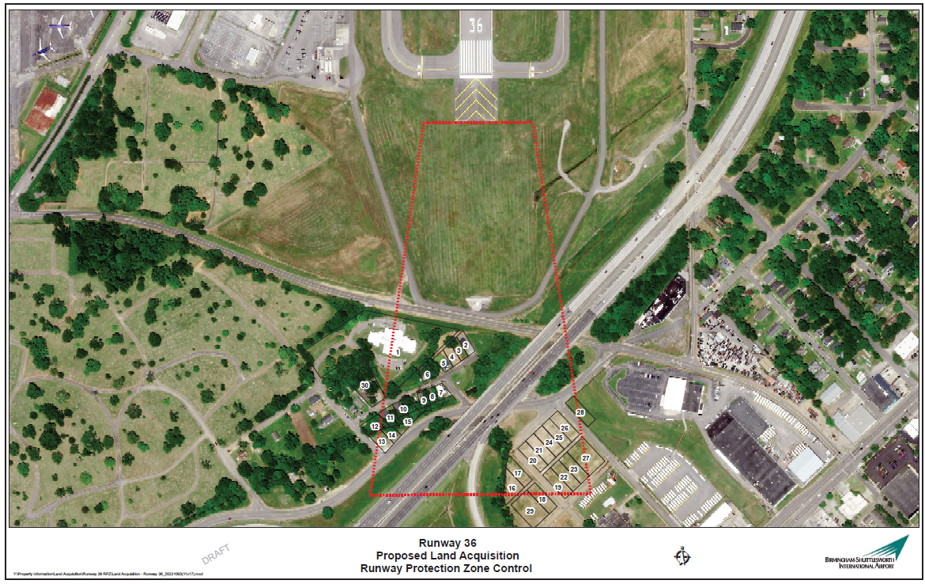
Appendix A Project Limits

Slide 7
Scope of Service and Requirements
Goals:
To enter into a contract with the most qualified firm for professional services to administer the acquisition of land within the Runway 36 RPZ.
To initiate acquisition of land in the Fall of 2025.
To obtain Signed Purchase Agreements by April of 2026.

Slide 8
  Anticipated Project Elements: The anticipated project elements necessary to successfully execute the proposed project are listed below. These are subject to change based on actual project needs determination.
    Obtaining right of entry and or access from landowners.
    Establishing Intent to Acquire and Authorization to Acquire.
    Hire of surveyors, appraisers, and review appraisers from State approved list.
    Preparation and delivery of all correspondence sent via Certified Mail-Return Receipt Request (CMRRR) according to all required rules, to landowner’s legal representative, including introduction letters, Landowner’s Bill of Rights and the Land Acquisition for Public Airport brochure.
    Secure all title work (preliminary title commitments, update title commitments as needed, title policies) and curative services necessary to provide clear title.
    Analyze appraisals and appraisal review reports and confirm the sponsor’s (airport’s) approval value prior to making offer for each parcel.
    Review Appraiser review of the originating Appraiser’s market information analysis in accordance with 49 CFR 24.103 and all applicable standards/requirements included in the Uniform Standards of Professional Appraisal Practice (USPAP) for Federal Land Acquisition and the AL Certification Statement.
    Prepare a separate negotiator contract report for each parcel, per contract, on applicable forms.
    Perform closing services in conjunction with the title company and attend closings. This will include recording of all acquired properties.
    Review title work prior to the closing by mail and prior to recording of the instrument.
    Knowledge and manner of acquisition notices.
    Provide all condemnation support using appropriate forms needed and shall appear and provide expert witness testimony as required.
    Provide recorded deeds and closing documents to the BAA for all properties acquired.

Slide 9
Submittal Requirements
A. Selection Process
This qualification-based selection process shall be in accordance with the current version of FAA Advisory Circular 150/5100-14, Architectural, Engineering, and Planning Consultant Services for Airport Grant Projects.
Award of this project would not preclude the awarded firm from future planning, environmental, design and/or construction services award with BAA. This applies to both prime firms and subconsultants.
A Statement of Qualifications (SOQ) and Project Proposal will be solicited from all interested firms. The SOQ will allow the opportunity to provide data relating to the experience and qualifications of the interested firm as it relates to the proposed project. The Project Proposal will include information to illustrate the firm’s category understanding, approach, and project management / communication plan.
Firms may be interviewed. However, BAA reserves the right to select the highest ranked consultant based solely upon submittals if sufficient information is included in the SOQ and project proposals.

Slide 10
B. Statement of Qualifications / Project Proposal
Please submit five (5) hard copies and one (1) electronic copy of your SOQ and Project Proposal submittal to the address below.
Contact: Ed Seoane, VP of Purchasing
Email: eseoane@flybhm.com
Address: Birmingham Airport Authority
5900 Messer Airport Highway Birmingham, AL 35212
Hard copies may be shipped via U.S. Postal Service or any other reputable courier service (e.g., Federal Express, UPS, etc.). The electronic copy must be included with the hard copies via a USB flash drive. Deliveries can also be made in-person to the BAA Office located on the ground level of the Terminal Building (located at the above address).
All questions associated with this RFQ must be submitted in writing via e-mail to Ed Seoane at eseoane@flybhm.com by the deadline identified for questions/clarifications (see timeline). Questions related to the RFQ directed to any other BAA personnel may be grounds for disqualification.

Slide 11
Statement of Qualifications / Project Proposal Format
Respondent’s SOQ and Project Proposal shall submit together as one submittal no longer than thirty (30) total pages of content (not including back / front cover, tabs dividers, cover letter, or table of contents). Each page must not be larger than 8.5” x 11”.
Statement of Qualifications Section Requirements
The SOQ portion of the submittal must include the following sections:
i. Firm Overview and Capability to Perform All Aspects of the Project:
ii. Recent Company Experience in Relevant Projects:
iii. Personnel Qualifications:
iv. Project Partners and DBE Goal Requirements:

Slide 12
Project Proposal portion must include the following sections:
Project Approach: Discuss the Scope of Services and how the firm will provide the desired services. Identify any potential technical challenges the firm anticipates during the project and how the firm intends to provide a successful outcome. Identify the proposed phasing of construction elements to minimize construction effects on airport users, including minimization of Runway 6/24 closures. Describe how the firm would consider design impacts beyond the immediate project site. Also, describe the steps your firm employs to minimize unforeseen or adverse conditions during construction.
Project Management / Communication Plan
Discuss any relevant information which would detail how the firm would manage the project process including, but not limited to scope of work development, project budget / schedule preparation, and quality control measures. Describe the process the firm employs to ensure quality in the cost estimation process including examples of recent cost estimates compared to actual bid results. Prepare a proposed project schedule including major tasks and target completion dates. Additionally, identify the firm’s plan for communication throughout the project to stakeholders including BAA, the FAA, other Federal, State, and Local governmental agencies, and project stakeholders (including tenants).

Slide 13
Statement of Qualifications / Project Proposal Evaluation Criteria
SOQs and Project Proposals will be evaluated and scored on a scale of 0 (lowest) to 100 (highest). In the event SOQs and Project Proposals are not considered sufficient to determine the highest ranked firms for either project, interviews will be conducted with up to the three (3) highest ranked firms. Additional interview scoring criteria will be provided in advance of the interview date, if necessary. Each criterion and its portion of the maximum scoring value is listed below:
Firm’s capability to perform all aspects of the project 20/100
Firm’s recent experience in relevant projects 15/100
Firm’s demonstration of personnel qualifications 10/100
Firm’s commitment to the DBE Goal 5/100
Firm’s proposed approach to the project 25/100
Firm’s proposed project management plan 15/100
Firm’s proposed communication plan 10/100

Slide 14
Tentative Selection Schedule
RFQ Posted August 15, 2025
Pre-Submittal Meeting August 21, 2025, 2 pm CST
Deadline for SOQ Questions/Clarifications September 4th, 2025, 2 pm CST
SOQ Deadline September 12, 2025, 2 pm CST
Recommendation to Award October 2025

Slide 15
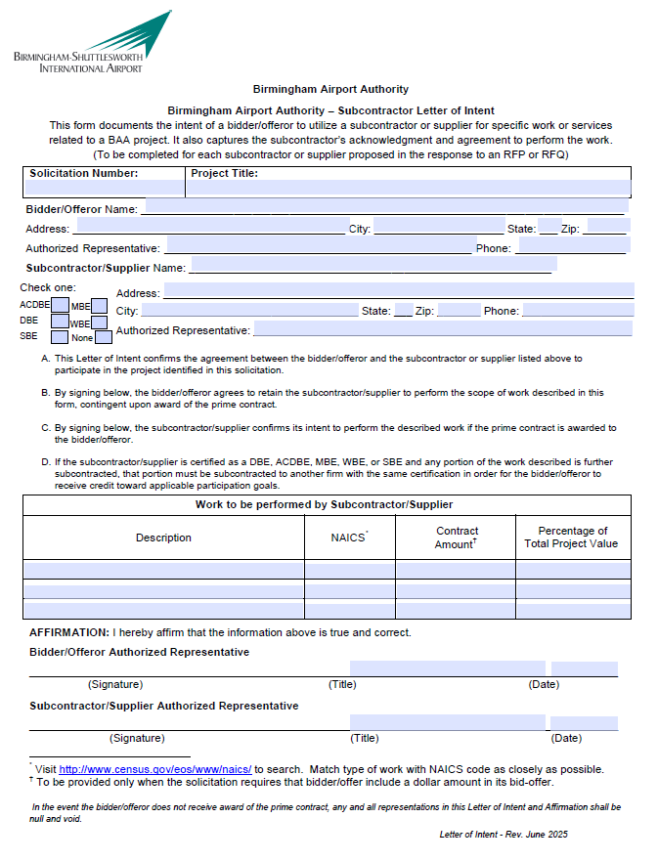
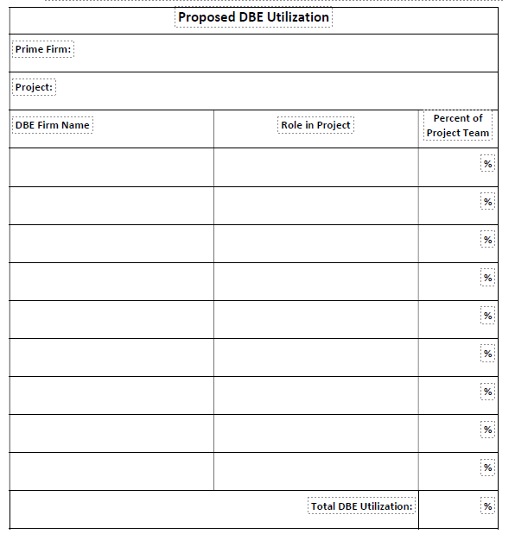
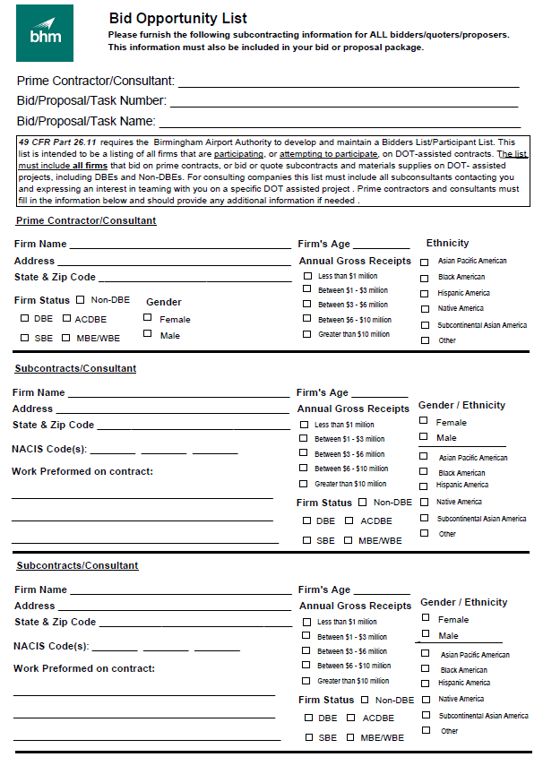
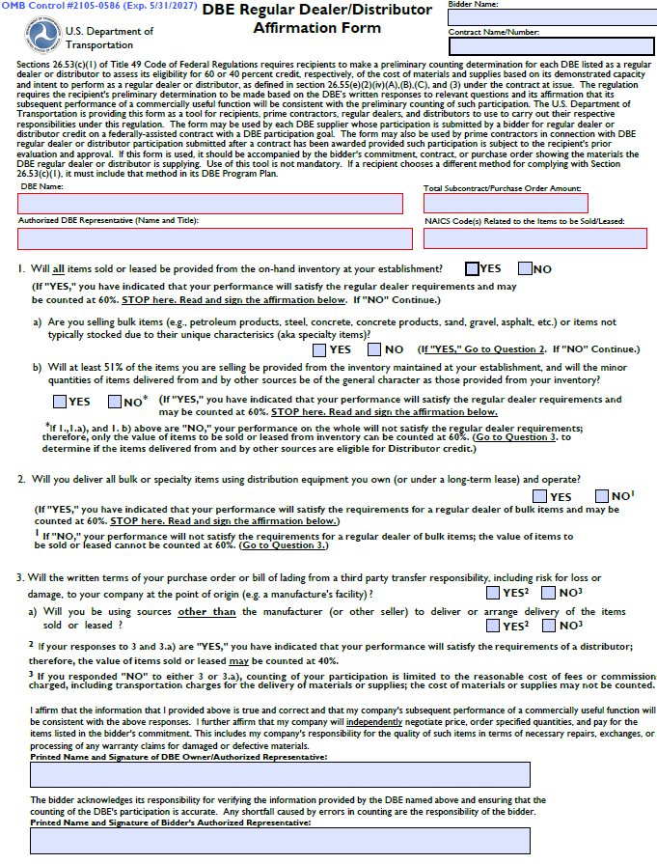
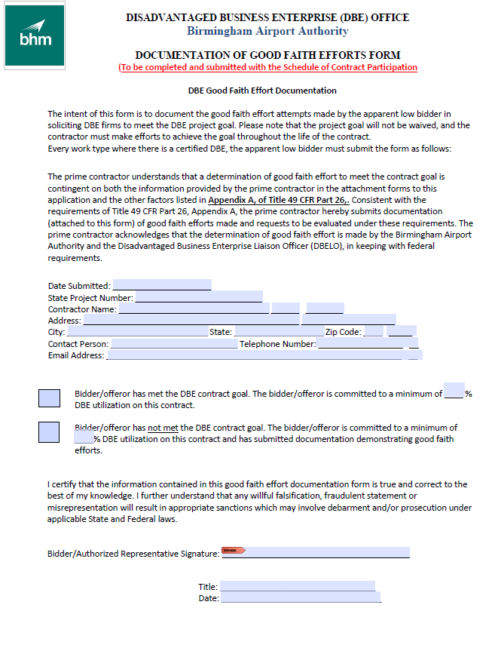
Appendix B - DBE Participation Certification
The following form is required to be completed and attached to the submittal. Failure to submit this form may be grounds for disqualification. Only firms certified as Disadvantaged Business Enterprises through the Alabama Unified Certification Program are eligible to be counted towards the DBE utilization for this Project. Inclusion of this form does not count towards the total page limit.

Slide 16
Civil Rights Assurances and Contract Goal
Title VI Assurance
The Birmingham Airport Authority, in accordance with the provisions of Title VI of the Civil Rights Act of 1964 (78 Stat. 252, 42 USC §§ 2000d to 2000d-4) and the Regulations, hereby notifies all bidders or offerors that it will affirmatively ensure that for any contract entered into pursuant to this advertisement, businesses will be afforded full and fair opportunity to submit bids in response to this invitation and no businesses will be discriminated against on the grounds of race, color, national origin (including limited English proficiency), creed, sex (including sexual orientation and gender identity), age, or disability in consideration for an award.
Contract Clause: Assurance Language Inclusion
    If awarded the Prime Contractor role, ALL Tier subcontracts/sub-agreements, whether with certified or non-certified DBE or SBE entities, must include the mandatory contract clauses for (nondiscrimination requirements/Title VI) compliance.
Contract Goal
    The contract has a 3% DBE participation goal.

Slide 17

THANK YOU
Questions
Insert Image

